Slide 1
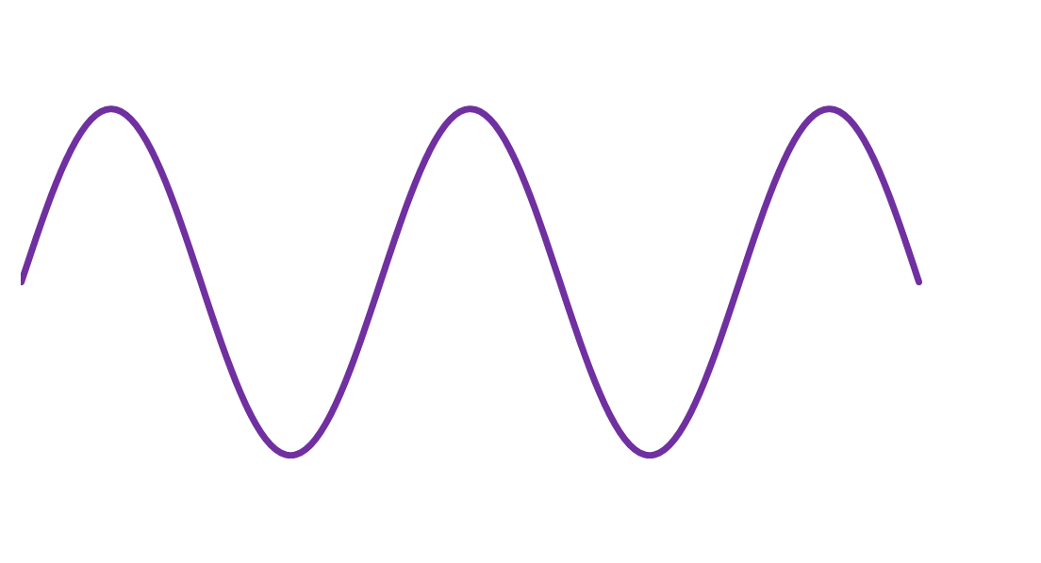




$$U_{inn}$$
$$+20\left[V\right]$$
$$t$$
$$−20\left[V\right]$$

Slide 2



$$U_{ut}$$
$$+0,7\left[V\right]$$
$$t$$
$$−20\left[V\right]$$

Slide 3
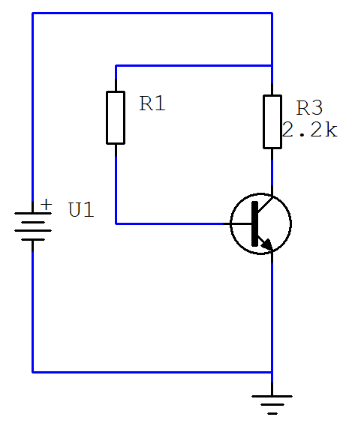



$$U_{CE}=7,2[V]$$
$$I_{B}=20[µA]$$
$$I_{E}=4[mA]$$

Slide 4




$$A_{1}$$
$$A_{2}$$
$$Signal inn$$
Forsterker
Gain = 3
Forsterker
Gain = 5
$$Signal ut$$

Slide 5



$$U_{inn}=10\left[mV\right]$$
$$U_{ut}=1\left[V\right]$$
$$600[Ω]$$

Slide 6




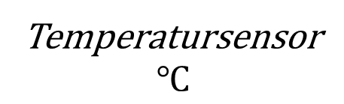


Temperatursensor
$$℃$$
$$F_{1}$$
$$F_{2}$$
Instrument
$$K_{1}$$
Forsterker
20 [dB]
Forsterker 16 [dB]
$$Kabel (−3\left[dB\right])$$

Slide 7





$$F_{1}=0,3$$
$$F_{2}=0,8$$
$$F_{3}=0,03$$
$$U_{inn}=5[V]$$
Tap i kobling
Tap i krets
Tap i utgangstrinn
$$U_{ut}$$

Slide 8





$$U_{inn}=5[V]$$
$$F_{3}=0,03$$
$$U_{ut}$$
$$F_{1}=0,3$$
$$F_{2}=0,8$$
Kontakt
-6 [dB]
Kable
-1,5 [dB]
Forsterker
48 [dB]
Fordeler
-6 [dB]

